Slide 1

AWS MANAGED SERVICES
By Faisal

Slide 2


Beginning Amazon Web Services
Chapters
Containers
Databases
Machine Learning
Serverless

Slide 3

Beginning Amazon Web Services
Containers
Amazon EKS
Managed nodes on EC2
Integrated with other services like ELB
Runs everywhere
Notes:
Amazon EKS works by provisioning (starting) and managing the Kubernetes control plane and worker nodes for you. At a high level, Kubernetes consists of two major components: a cluster of 'worker nodes' running your containers, and the control plane managing when and where containers are started on your cluster while monitoring their status
Runa anywhere from outpost to cloud to your own infra

Slide 4
Beginning Amazon Web Services
Containers
Amazon EKS
Container orchestration
AWS Opinionated
Runs everywhere
Powers some internal AWS services
Amazon ECS

Slide 5
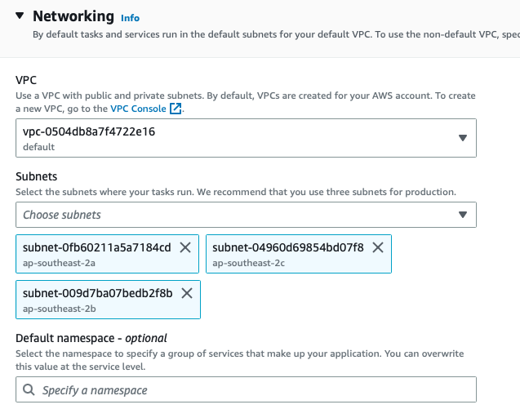
Beginning Amazon Web Services
Containers
Amazon EKS
Amazon ECS

Slide 6
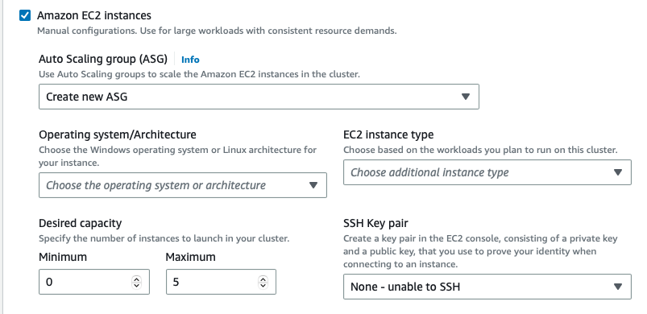
Beginning Amazon Web Services
Containers
Amazon EKS
Amazon ECS

Slide 7
Beginning Amazon Web Services
Containers
Amazon EKS
Amazon ECS
AWS Fargate

Slide 8
Beginning Amazon Web Services
Databases
Amazon RDS
Managed database
HA
Automatic upgrades
Notes:
VPC
AZ
Subnets
Internet Gateway

Slide 9
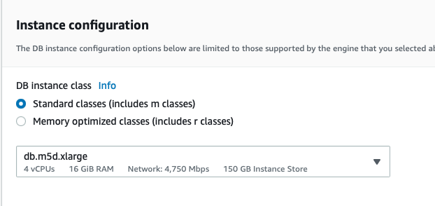
Beginning Amazon Web Services
Databases
Amazon RDS
Notes:
VPC
AZ
Subnets
Internet Gateway

Slide 10
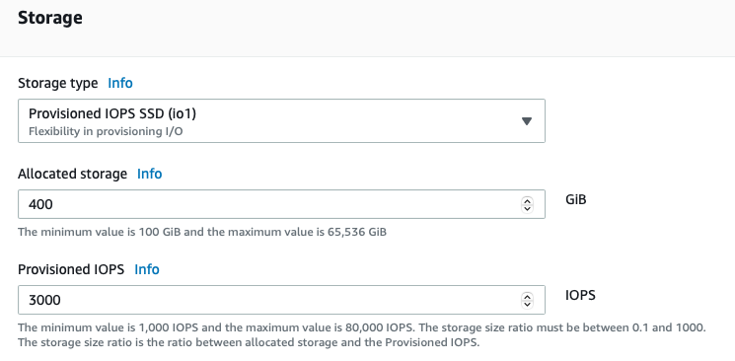
Beginning Amazon Web Services
Databases
Amazon RDS
Notes:
VPC
AZ
Subnets
Internet Gateway

Slide 11
Beginning Amazon Web Services
Databases
Amazon RDS
Amazon Aurora
Notes:
VPC
AZ
Subnets
Internet Gateway

Slide 12
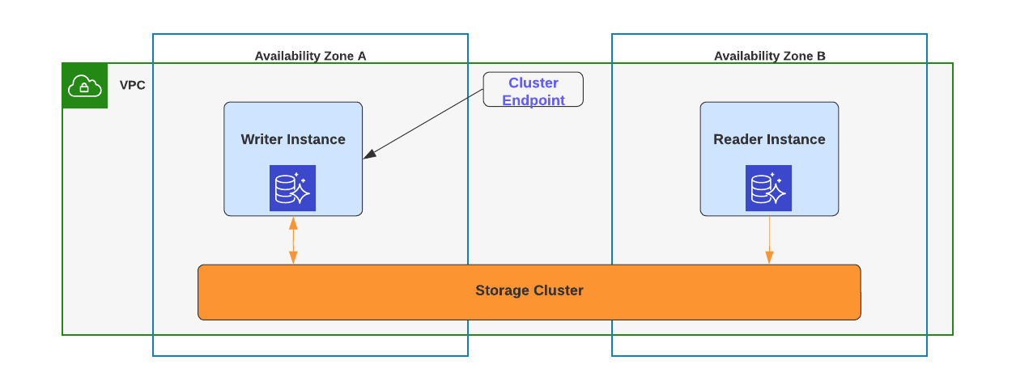
Beginning Amazon Web Services
Databases
Notes:
VPC
AZ
Subnets
Internet Gateway

Slide 13
Beginning Amazon Web Services
Databases
X
Writer
Notes:
VPC
AZ
Subnets
Internet Gateway

Slide 14
Beginning Amazon Web Services
Databases
Amazon RDS
Managed No-SQL database
Multi-region capable
DAX
Amazon Aurora
Amazon DynamoDB
Notes:
VPC
AZ
Subnets
Internet Gateway

Slide 15
Beginning Amazon Web Services
Machine Learning
Amazon Sagemaker
Label and prepare datasets
Training and training environments
Inference
Notes:
GroundTruth (annotate, label dat), data processing, feature store
Notebook, sagemaker studio (end to end(, autopilot, distribyted training etc
Sagemaker pipeline, inference, http endpoints

Slide 16
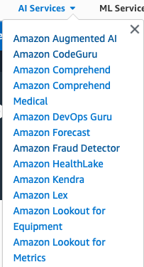
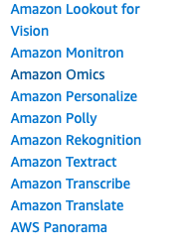
Beginning Amazon Web Services
Machine Learning
Amazon Sagemaker
ML services as API
Notes:
Cloud innovate on your behalf

Slide 17
Beginning Amazon Web Services
Machine Learning
Amazon Sagemaker
Amazon EMR
AWS Lake Formation
Amazon Redshift
ML services as API
Analytics
Notes:
EMR = Big Data, Spark, Hive, Presto
Lake = crawlers, catalog, access control, ETL

Slide 18
Beginning Amazon Web Services
Serverless
AWS Lambda
No need to manage runtime, scaling or host
Notes:
a generic environment within which we can run our own software. Some people like to use the term serverless compute instead of FaaS.
he platform itself calls our functions by instantiating a dedicated environment for each event
Does not require managing a long-lived host or application instance Self auto-scales and auto-provisions, dependent on load Has costs that are based on precise usage, up from and down to zero usage Has performance capabilities defined in terms other than host size/count Has implicit high availability

Slide 19
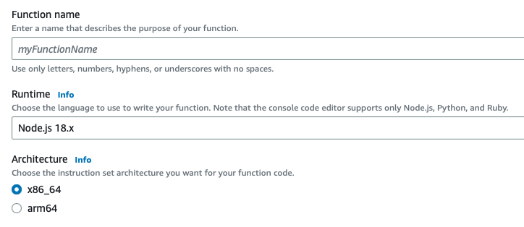
Beginning Amazon Web Services
Serverless
AWS Lambda
Notes:
a generic environment within which we can run our own software. Some people like to use the term serverless compute instead of FaaS.
he platform itself calls our functions by instantiating a dedicated environment for each event
Does not require managing a long-lived host or application instance Self auto-scales and auto-provisions, dependent on load Has costs that are based on precise usage, up from and down to zero usage Has performance capabilities defined in terms other than host size/count Has implicit high availability

Slide 20
Beginning Amazon Web Services
Serverless
AWS Lambda
No need to manage runtime, scaling or host
Backend as a service
Function as a service
Notes:
a generic environment within which we can run our own software. Some people like to use the term serverless compute instead of FaaS.
he platform itself calls our functions by instantiating a dedicated environment for each event
Does not require managing a long-lived host or application instance Self auto-scales and auto-provisions, dependent on load Has costs that are based on precise usage, up from and down to zero usage Has performance capabilities defined in terms other than host size/count Has implicit high availability

Slide 21
Beginning Amazon Web Services
Serverless
AWS Lambda
State Machine
State and task orchestration is managed
Auditable workflow
AWS Step Functions

Slide 22
Beginning Amazon Web Services
Serverless
AWS Lambda
AWS Step Functions
Amazon Aurora Serverless

Slide 23

Beginning Amazon Web Services
Summary
Managed Services
Serverless
Next Steps
Notes:
Talk about how easy is to start. Just logni to aws console and start trying…

